Slide 1
Driving Teams Adoption With a Bot
Kevin McDonnell
Solutions Architect, CPS
16 November 2019
Notes:
This session will be about driving adoption of Microsoft Teams by using a Bot and specifically a game or challenge style Bot. I’ll cover a little about ways of approaching adoption, the ways I recommend and then delve in to the Bot I’ve created to support this.

Slide 2
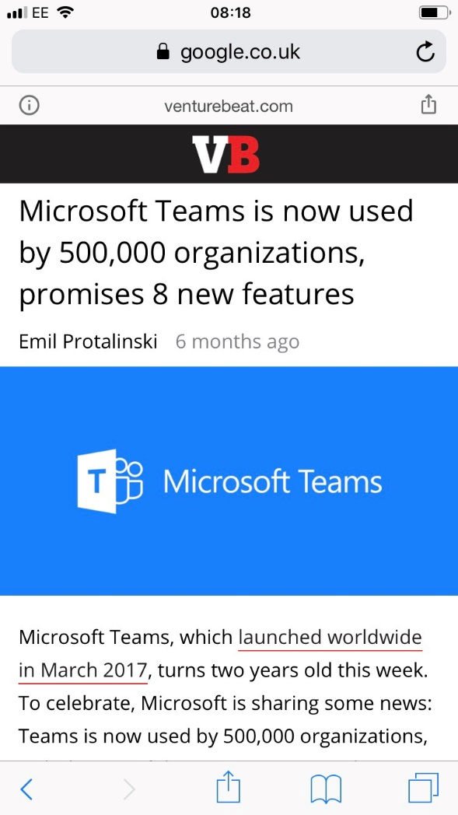
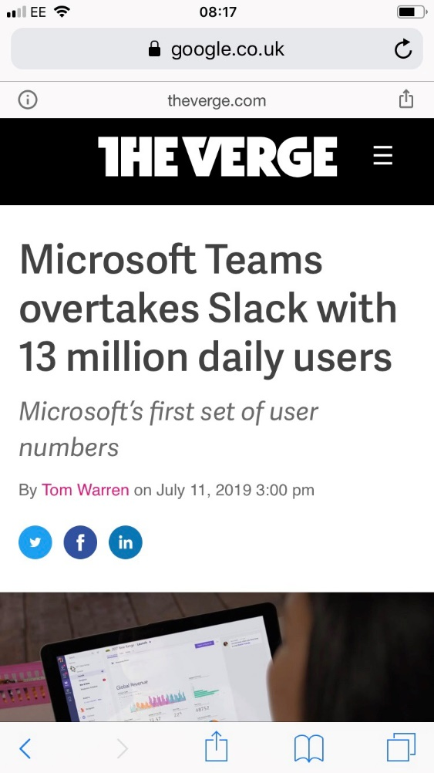
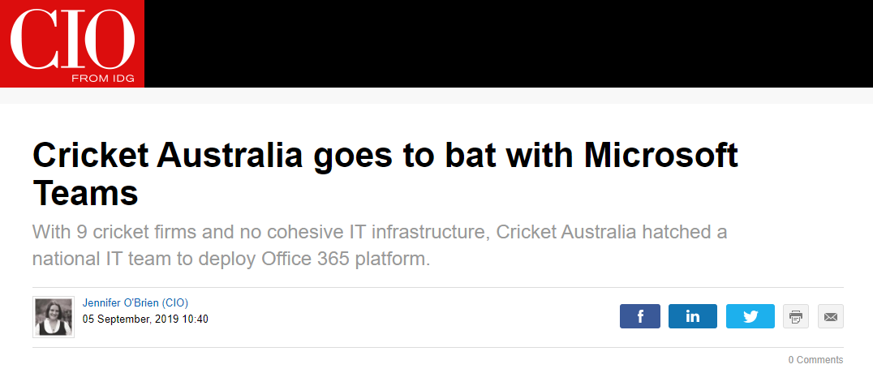
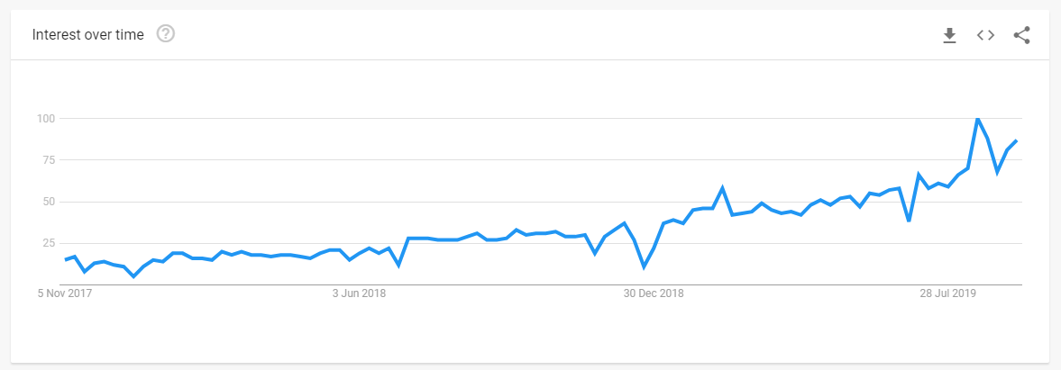
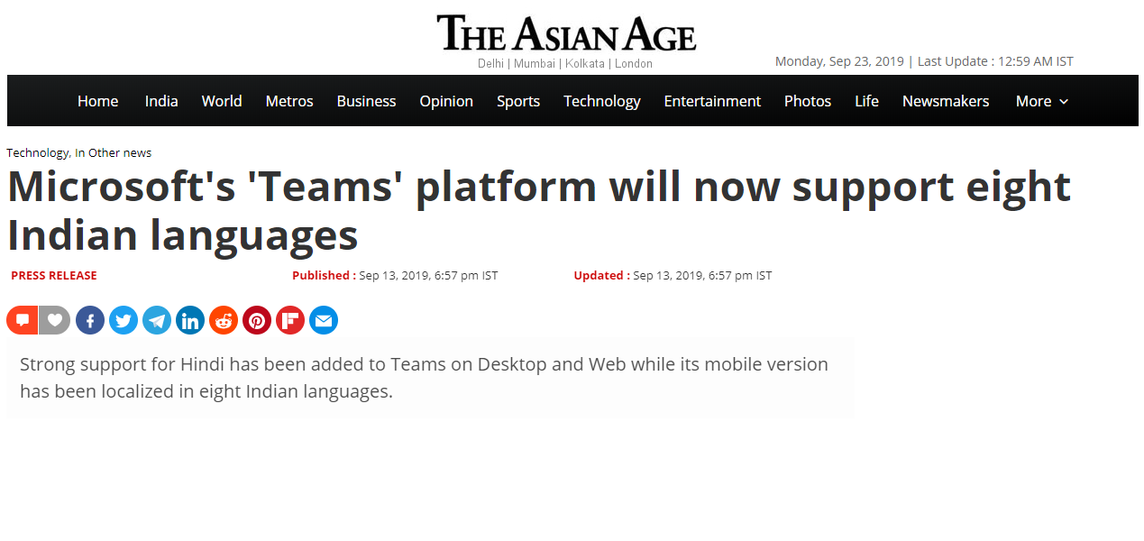
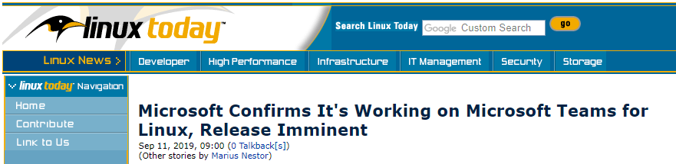
Microsoft Teams is huge and is getting bigger
Notes:
Teams has been such a popular tool
Chart shows the google trends growth and…
500k orgs in March, 13 million daily users in July – who knows how big it is now. It’s being used by Cricket Australia which may be why they were so lucky in the Ashes and it can support eighth Indian languages to show how it is not just growth in English speaking countries that is driving the growth.
It even has a Linux client being developed for it which shows it’s a whole new Microsoft.
Just a little about me

Slide 3
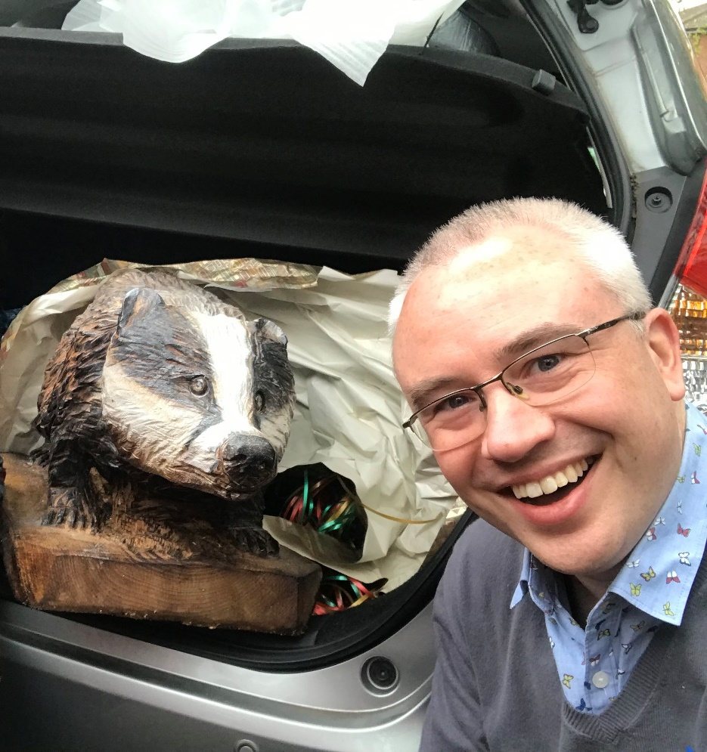
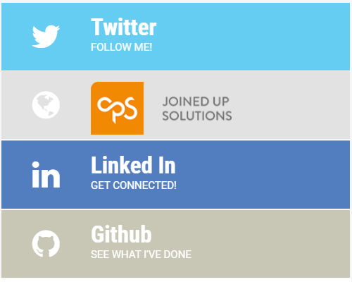

Who am I?
Kevin McDonnell
Solutions Architect - CPS
https://www.mcd79.com
@kevmcdonk
https://www.cps.co.uk
/kevmcdonnell
/kevmcdonk

Slide 4
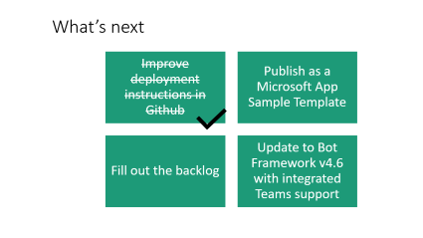
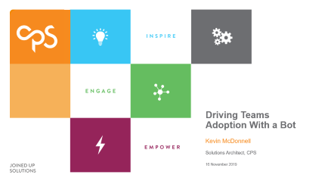
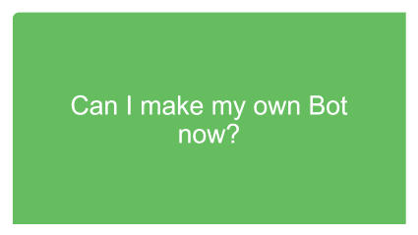
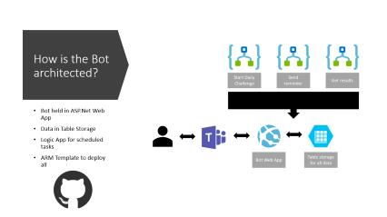
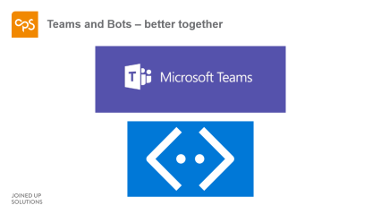
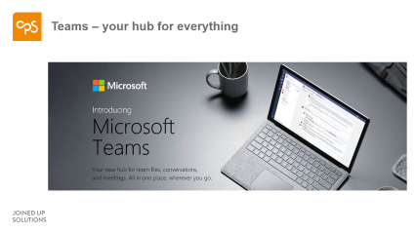

Session map
Notes:
I’m going to start off talking about Teams and adoption for Teams before moving on to using Bots with Teams, including a demo of the WhereOnEarthBot

Slide 5
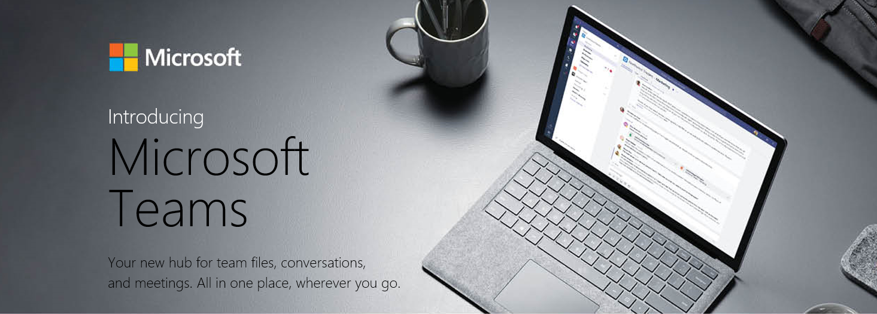
Teams – your hub for everything
Notes:
Organisations are loving the ability to create hubs of collaboration with chat, voice and content in one place for a common purpose. So does that mean you can turn it on and just sit back and watch the magic? Sadly not.
You can have great technology that will support digital transformation but if no one uses it, you have an expensive mistake.

Slide 6
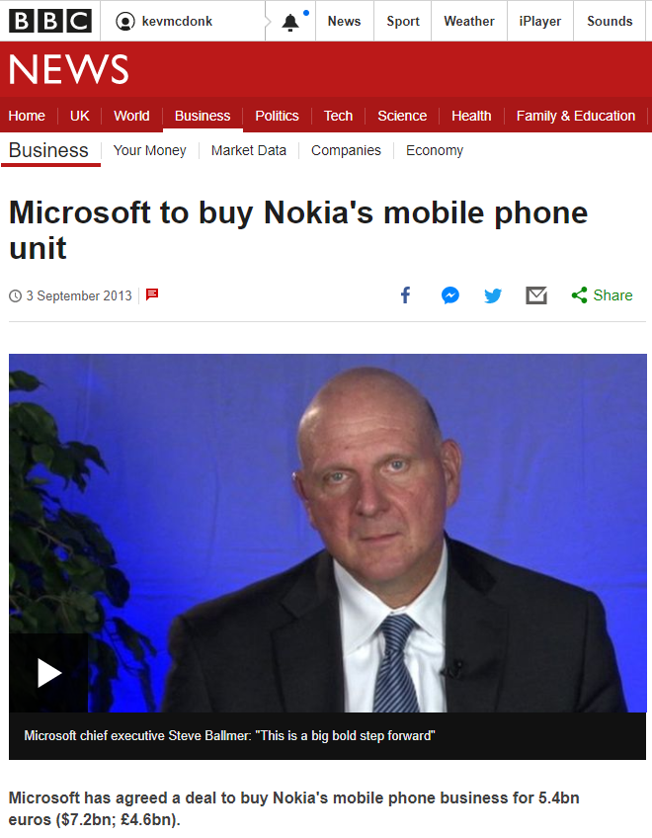
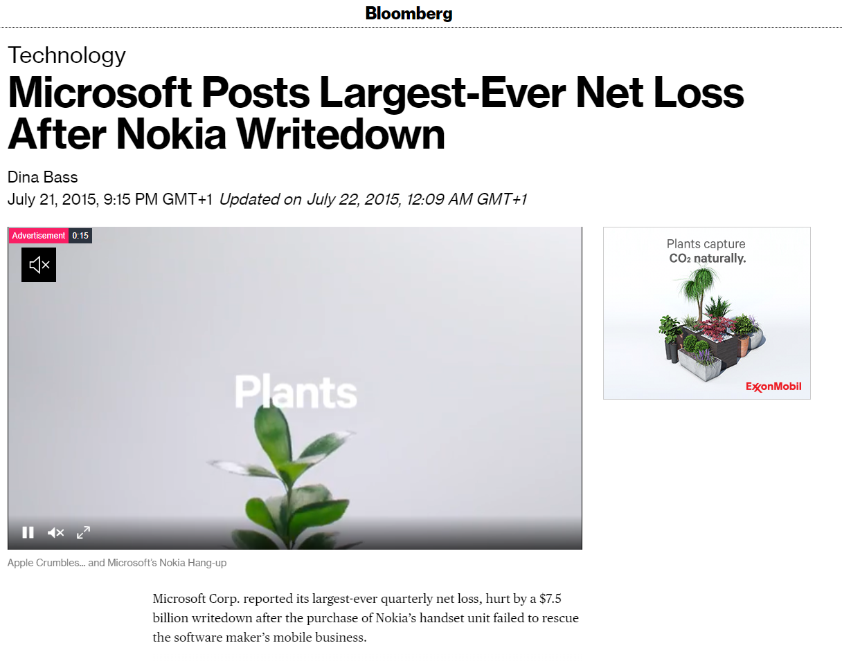
Ooops
Notes:
Microsoft had a great product with Windows Phone and bought out a great company’s product. But they failed to make the most of it.
…
…

Slide 7

Sega loses out
Notes:
Further back, Sega followed up the Master System and Megadrive (or Genesis to any US viewers) with the Dreamcast. It didn’t build the marketing hype that Xbox and Playstation pushed and despite a well loved product from those who used it, it couldn’t keep away the dominance of Xbox and PlayStation.

Slide 8



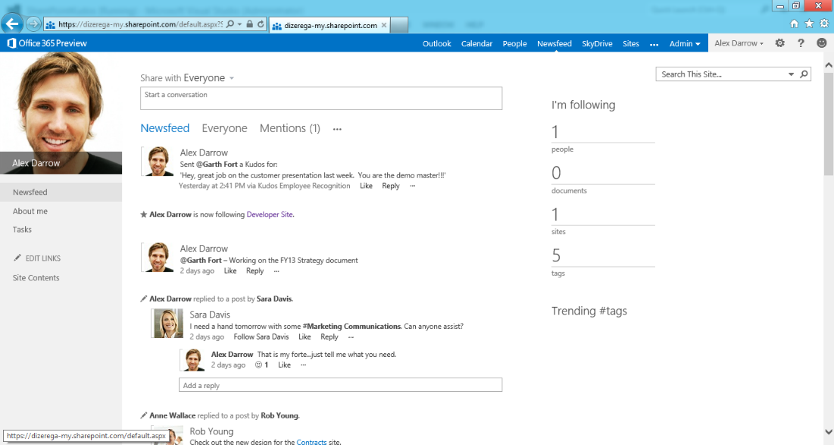

Failed Enterprise Social Networks
Notes:
Many of you would have heard of or even been involved with large budget roll outs of enterprise social projects over the last decade or so. Huge investments in products that soon languished in folklore as people stuck with email.
…
…

Slide 9
Why?

Slide 10
Reasons why the projects fail
Resistance to change
Staff in their comfort zone
People too busy
Lack of adoption planning
Notes:
https://www.cygnet-infotech.com/blog/these-mistakes-may-fail-your-new-technology-adoption-project
Images by rawpixel, Free-Photos and Brian Merrill from Pixabay and
Todd MacDonald from Unsplash

Slide 11
How?

Slide 12
Techniques for driving adoption
Engage stakeholders
Find a purpose to showcase
Support extension of scope and embrace new ideas
Notes:
Talk about how to adopt
Engage stakeholders
Find a purpose to showcase
Support extension of scope and embrace new ideas
https://docs.microsoft.com/en-us/microsoftteams/continue-journey
Image by rawpixel from Pixabay
Image by Ryan McGuire from Pixabay

Slide 13




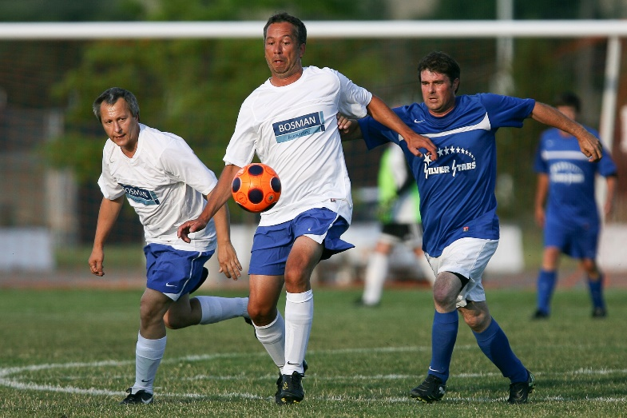
Driving enterprise social through social staff
Notes:
However one of the best ways I have seen this work is through fun. After seeing an enterprise chat tool rolled out at a large financial services organisation, what made it take off was the chat. Food chat, football chat, photography chat - all were popular groups.
Built communities of interest
Built understanding of using chat
Soon moved to use within Teams and projects
Image by Keith Johnston from Pixabay
Image by Public Co from Pixabay
Image by Robert-Owen-Wahl from Pixabay
mage by Malachi Witt from Pixabay
Image by Clker-Free-Vector-Images from Pixabay

Slide 14
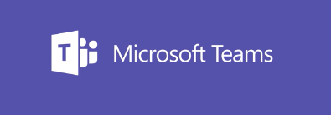

Teams and Bots – better together
Notes:
This made me think about the same idea with Teams rollout. Building understanding through more social chat groups. But Teams brings more. File sharing, app integration, meetings and also Bots. Bots. Now there’s an idea.
In a previous role, someone (Thanks Mark Slavik) asked someone if they knew where the Bing background was. Then again the next day. Soon it became a daily challenge. More and more people got involved and it became a great way for new people to get to know the team. It became as much about the chat and the laughing at how bad we were at guessing.
Having explored the Bot Framework, I decided to look at saving some time for Mark.

Slide 15

Demo
Notes:
Start a demo of the Bot with one user
Talk about the scheduling of it.
Give some examples of the chat that goes on.
Show leaderboard with PwerBI

Slide 16
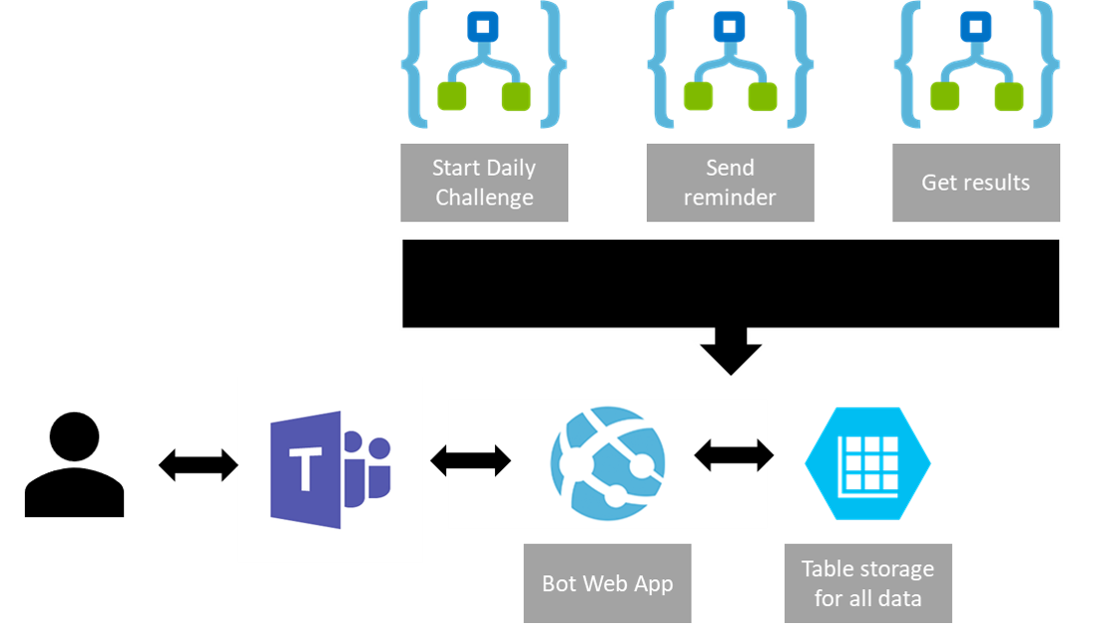

How is the Bot architected?
Bot held in ASP.Net Web App
Data in Table Storage
Logic App for scheduled tasks
ARM Template to deploy all
Notes:
Talk about how the Bot Framework creates an ASP.Net web app with an api at /api/messages. All calls go through there. Authentication using an Azure App registration.
Talk about data in Table Storage. Logic App triggers reminders.
Next talk a little about designing a new Bot. Note that there is an Azure Template for creating a Bot so can be very easy.

Slide 17
Can I make my own Bot now?

Slide 18
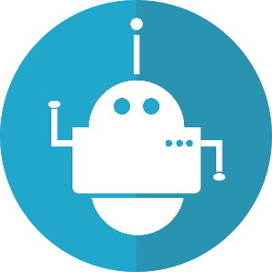
Planning your own Bot
Triggers
Why
Should it be a Bot
Standard app planning process
Dialogs
Triggers
How to start the Bot
User triggered or scheduled/event driven
Actions
Dialogs
The Flows of conversation
Groups of chat
Actions
What the Bot does
Triggering to other systems (if needed)
YourBot
Notes:
Getting started with Bots and the Bot Framework could be its own session on its own (something I am thinking about if there is interest) so I’m just going to pick up some high-level areas.
The key is the structure. First you start with Why you are making this a Bot and even why you are making an app at all. Define the personas, user journeys and user stories as you would with any other app but particularly challenging why this is a Bot. Teams adoption is a great reason but some scenarios may just better fit a more screen based app. For example a leave booking system where you want to see all your leave could be very painful as a bot and any users.
Assuming that a Bot fits, you then start to design the triggers for engaging your Bot. This could be user driven by mentioning the Bot in Teams through @ mentions or it could be event driven. In the WhereOnEarthBot, there are both – the timed trigger at the start of each day to get going is then followed up byt user driven mentioning to add the guesses.
Then start to plan out the dialogues. These are like snippets of conversation for a specific purpose and can be similar to the screens that you would define for a standard UI driven app. You will also define how you move between these dialogues as you do with screens. More on this in a minute.
Finally, you want to think about the actions your bot will take. Is it just using pre-canned responses that are hard coded or will it be retrieving information from a system. Does it need to update other systems like a leave booking system? These actions need to be plotted out so that authentication and access can be planned.
That give you YourBot but let’s use the WhereOnEarthBot as an example

Slide 19

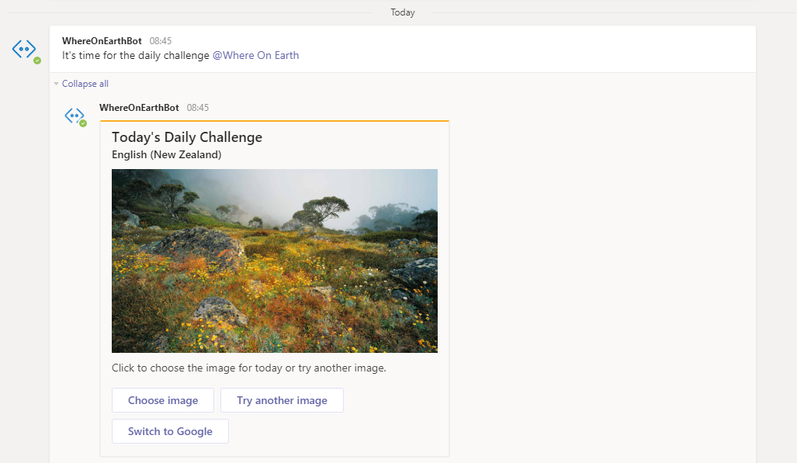
A little more on dialogs
Start the challenge
Choose Image Dialog
Gather Guesses Dialog
Get Results Dialog

Slide 20
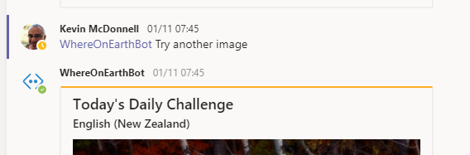
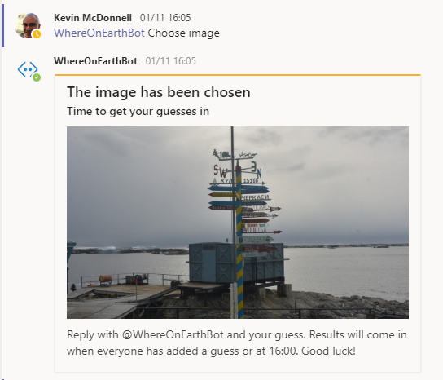
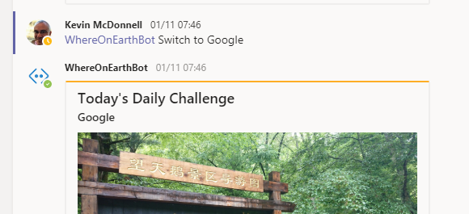
A little more on dialogs
Start the challenge
Choose Image Dialog
Gather Guesses Dialog
Get Results Dialog

Slide 21
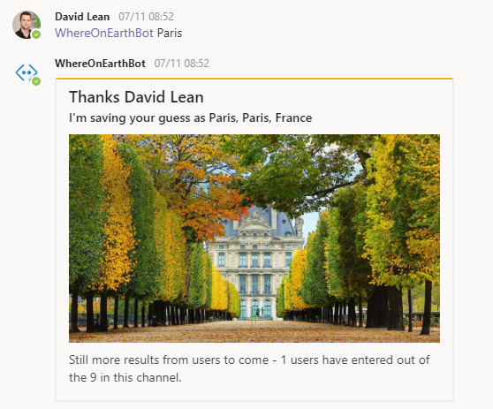
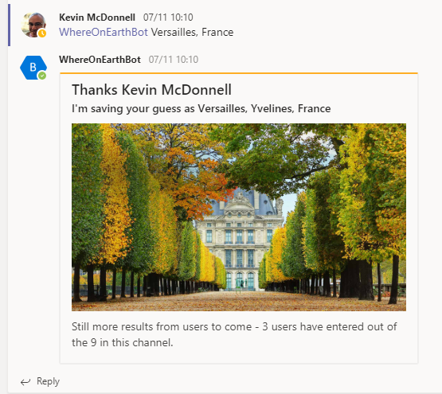
A little more on dialogs
Start the challenge
Choose Image Dialog
Gather Guesses Dialog
Get Results Dialog

Slide 22
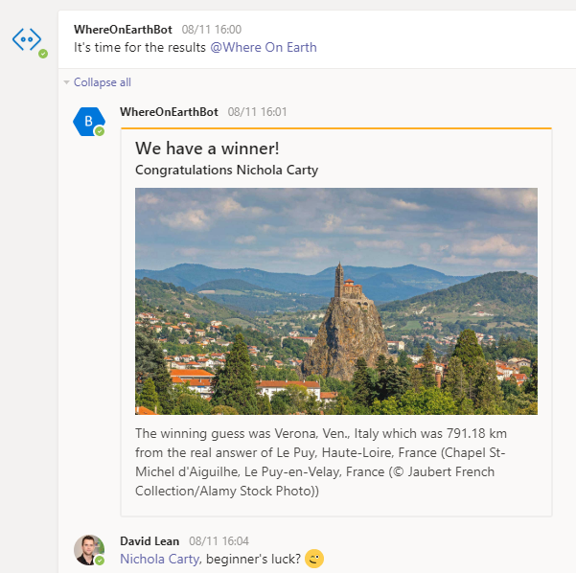
A little more on dialogs
Start the challenge
Choose Image Dialog
Gather Guesses Dialog
Get Results Dialog

Slide 23
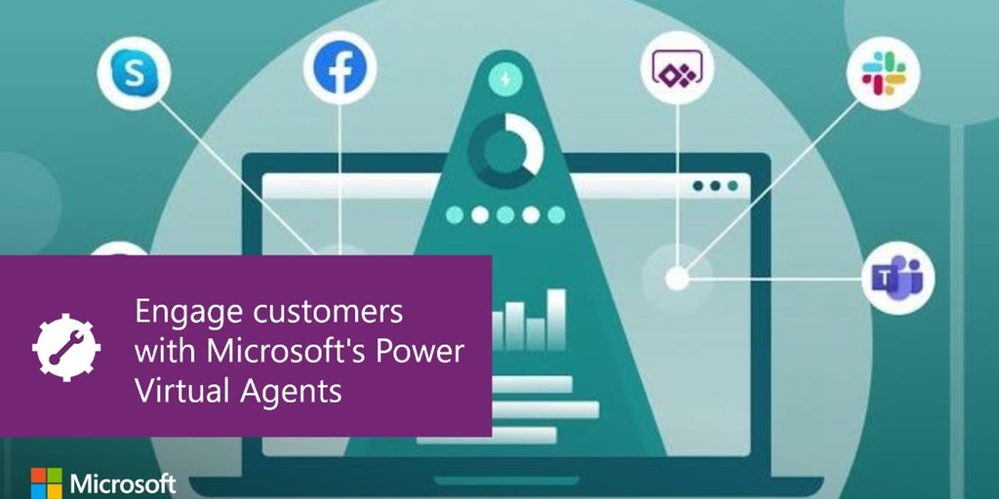

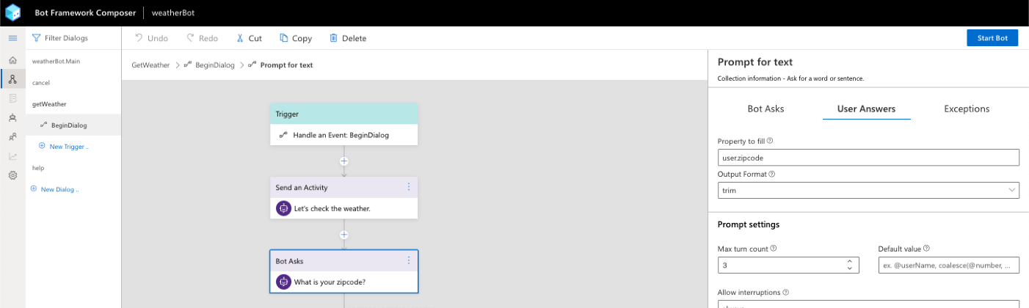

Prototyping your own Bot
Power user driven Bots that can link with Power Automate
Open Source UI for designing Bot Framework Bots
Fresh updates from Ignite 2019
Notes:
Talk about a Bot having a Main Dialog to say hello and then sub dialogs to handle different blocks of conversation.
Show the code with the different conversations of gathering the Bot request and then moving to selecting the pick and finally triggering the answer.
Talk about triggered responses.

Slide 24

What’s next
Publish as a Microsoft App Sample Template
Fill out the backlog
Improve deployment instructions in Github
Update to Bot Framework v4.6 with integrated Teams support

Slide 25
Some useful links
Power Agents Preview - https://powervirtualagents.microsoft.com/
Bot Framework Composer - https://github.com/microsoft/BotFramework-Composer
The Where On Earth Bot repo - https://github.com/kevmcdonk/WhereOnEarthBot
Bot Framework SDK with Teams - https://docs.microsoft.com/en-us/azure/bot-service/bot-builder-basics-teams?view=azure-bot-service-4.0&tabs=csharp

Slide 26














Thank you TO Our Sponsors

Slide 27
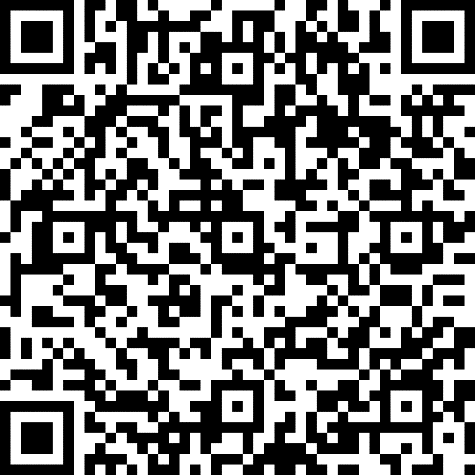
Please evaluate my session
http://bit.ly/SPSLeics2019

Slide 28

Any questions?

